Slide 1

A Comparative Analysis of Venue Interest in Kobe City and Osaka City Japan Using Foursquare API Data
Coursera – IBM Data Science Capstone Project

Slide 2
Table of Contents
Item | Page
Background | 3
Problem and Interest | 4
Data Analysis and Hypothesis | 5
Methodology | 6
Results & Discussion | 7 – 9
Limitations and Drawbacks | 10
Conclusion | 11
References | 12
Coursera – IBM Data Science Capstone Project Achala Amarasinghe
2

Slide 3
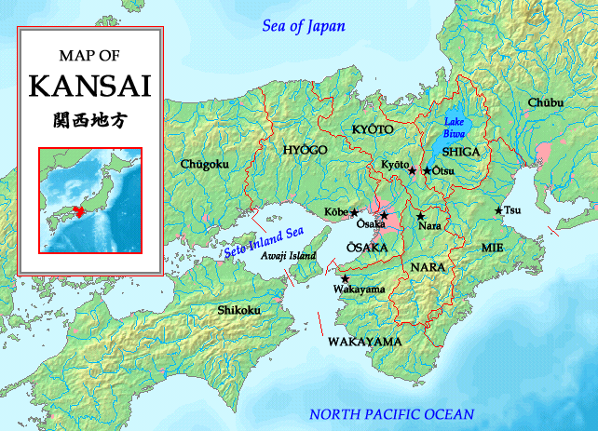
Background
Kobe is a cosmopolitan city that has historically been well known for maritime trade and is a popular business and tourist destination in the Kansai region. Although Osaka remains as the most populous city in the Kansai region with a population of over 2.5 million (World Population Review, 2021, Kobe University, 2016 & Public Information Division, Office of the Mayor, City of Osaka, 2020), Kobe remains as a highly recommended tourist location throughout the year – not just for the world renowned Kobe-beef, but for also its hot springs, mountain hikes and European style architecture that can be found throughout the city (Trip.com, n.d. & Audiger,S., n.d. ).
While Kobe, Osaka and other cities in the Kansai region were expected to be popular targets for attracting tourists in the weeks leading up to the 2020 Tokyo Olympics, the effect of the global pandemic has played an effect on each city’s economy.
Considering this, the use of spatial data could help to provide an insight to understanding present-day trends, which can become a basis for what to expect in terms of the demand and appeal of popular locations in a post-CoVID-19 world.
Map of Kansai Region, Japan
Coursera – IBM Data Science Capstone Project Achala Amarasinghe
3

Slide 4
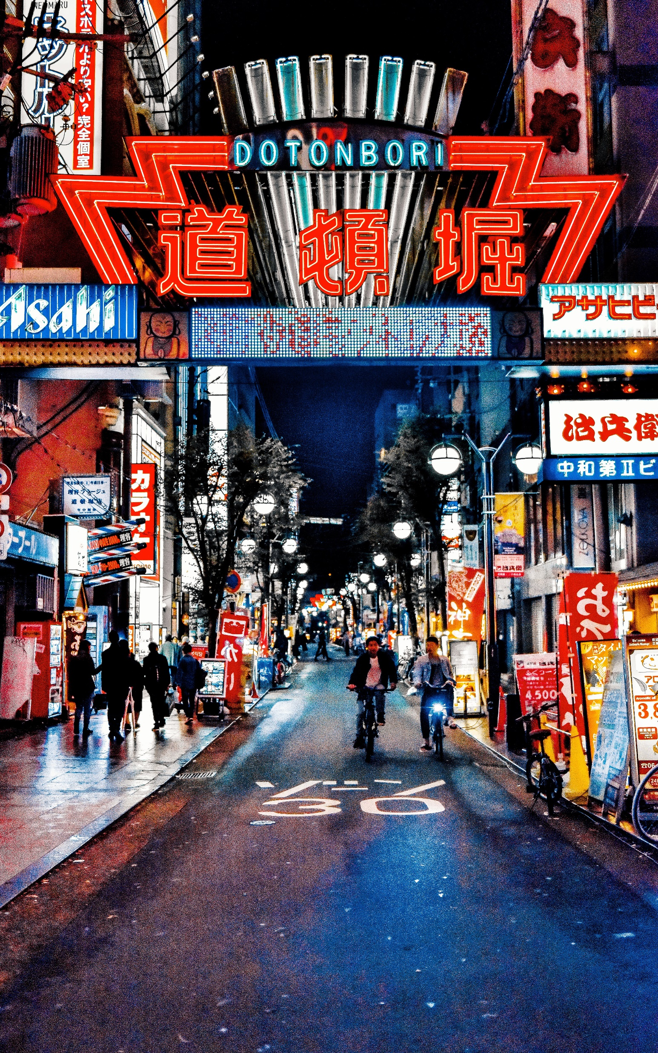
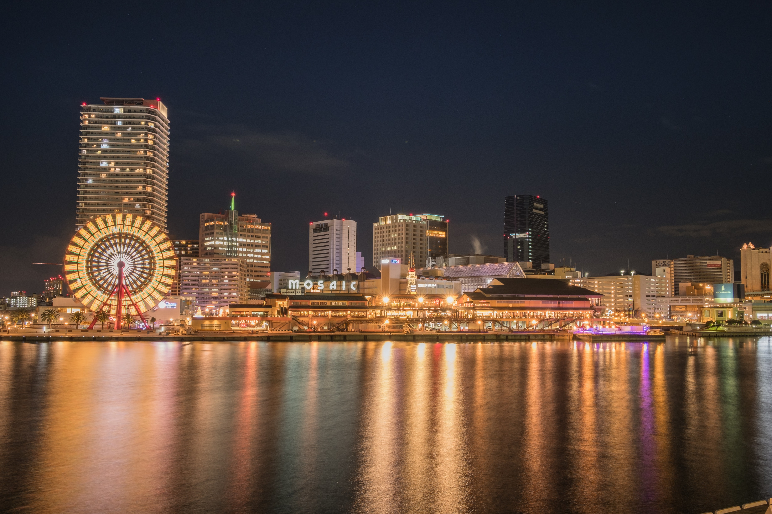
Problem and Interest
Objective: To understand key venue categories and the top 10 venues within each category around the following train stations - Umeda Station, Osaka - Sannomiya Station, Kobe
Rationale: To assist the following stakeholder groups in terms of key decision making for real-estate investment and CoVID-19 infection risk:
The City Hall
Business owners and individuals
Real-estate and construction companies
Business owners and entrepreneurs .
Left: Dotonbori Street, Osaka Bottom: Bayside view of Kobe City
Coursera – IBM Data Science Capstone Project Achala Amarasinghe
4

Slide 5
Data Analysis Aim and Hypothesis
Data Source: - Foursquare API for venue popularity and categories within 1 km radius of target train stations
Aims: - To understand where people are most likely to travel to within the most crowded/travelled part of each city, since major train stations are focal points for individuals when travelling / shopping. - To discern the most popular venues within each category to identify venues - To identify any comparative patterns between the data from both cities using K-means clustering
Hypothesis: - Venues that remain highly popular during the state of emergency are businesses that are stable, essential or have implemented means of remaining safe for individuals to visit.
Coursera – IBM Data Science Capstone Project Achala Amarasinghe
5

Slide 6
Methodology
Stage 1 – Initial Data Extraction In order to determine the key venue categories between each major city, the first stage will involve using data from Foursquare's API will be used to understand the following - most popular venue categories - 25 most popular venue within each category within a 1000 meter (1km) radius from each station.
Stage 2 –Model Building and Comparison The second stage of this process would be to compare & contrast the results of the two cities which will be done in two stages: - Step 1: A direct (manual) comparison and interpretation of the data based on the results of stage. - Step 2: A machine learning based comparison of data using K-means clustering with the same results from stage 1 to generate the 10 most popular venues
Stage 3 - Model Execution
The final stage of the data analysis process would involve testing the k-means clustering model with a larger set of data by increasing following variables for two other cities (Tokyo and Sapporo)
- most popular venue categories
- most popular venue within each category
- a 1000 meter (1km) radius from each station for each venue
The results of this stage would again be compared with the initial results of the K-means Clustering Model to understand any patterns based on distance in relation to the most popular category
Coursera – IBM Data Science Capstone Project Achala Amarasinghe
6

Slide 7
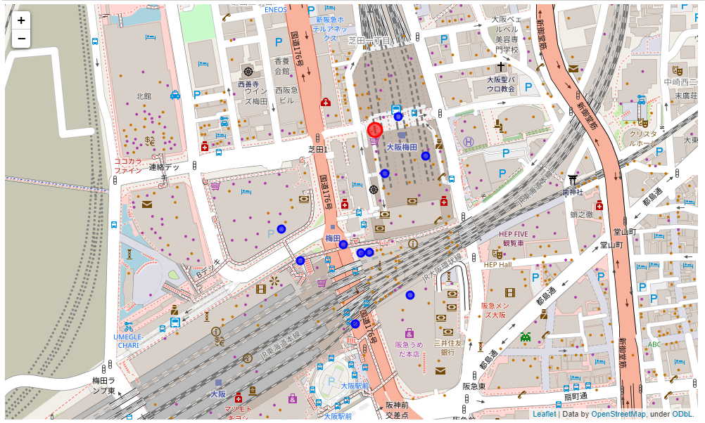
Results and Discussion I
Initial Foursquare Data Comparison (Osaka and Kobe)
Venue name | Venue Category | Distance (in meters)
Rilakkuma Store (リラックマストア) | Hobby Shop | 37
Ueshima Coffee House (上島珈琲店) | Coffee Shop | 45
Honmiyake (本みやけ) | Nabe Restaurant | 62
Indian Curry (インデアンカレー) | Japanese Curry Restaurant | 79
スヌーピータウンショップ 大阪梅田店 | Toy / Game Store | 97
Fig 1.1 Closest venues from the station, Osaka
Fig 1.2 Map highlighting top 10 key venues (blue dots) around Umeda Station, Osaka (red dot)
Coursera – IBM Data Science Capstone Project Achala Amarasinghe
7

Slide 8
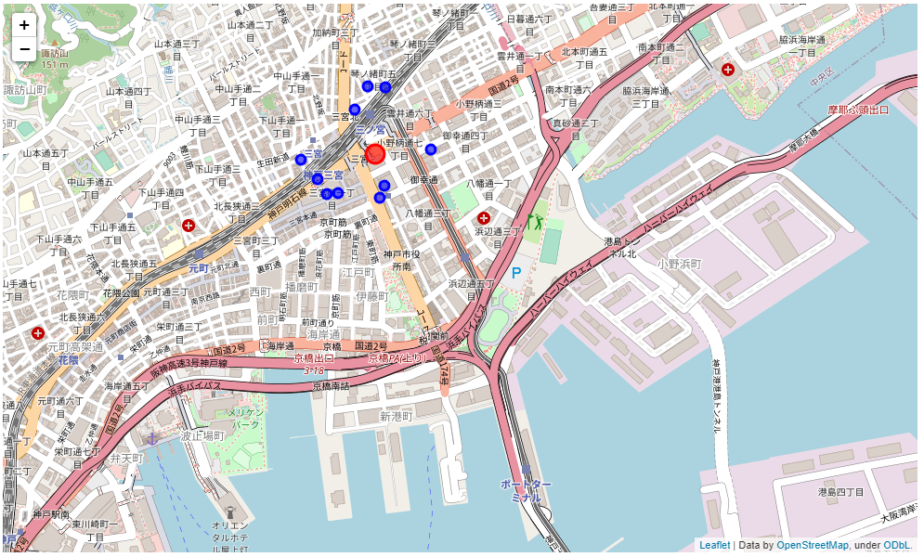
Results and Discussion I
Initial Foursquare Data Comparison (Osaka and Kobe)
Venue name | Venue Category | Distance (in meters)
Baskin-Robbins (サーティワン アイスクリーム 三宮フラワーロード店) | Ice Cream Shop | 132
Kobe Kokusai Hall (こくさいホール) | Concert Hall | 137
Kobe International House (神戸国際会館) | Convention Center | 140
Hakata Motsunabe Yamaya (博多もつ鍋やまや JR三ノ宮店) | Japanese Restaurant | 150
Boulangerie Comme Chinois (ブランジェリー コム シノワ) | Bakery | 169
Fig 1.3 Closest venues from the station, Kobe
Fig 1.4 Map highlighting top 10 key venues (blue dots) around Sannomiya Station, Kobe (red dot)
Coursera – IBM Data Science Capstone Project Achala Amarasinghe
7

Slide 9

K-Means Analysis Logic
Identify relationship between category and city using one-hot encoding
Discern most popular venue in relation to category and city by categorizing the top 10 venues in respect to each other.
Understand if the results show a direct correlation between relative distance from the station and the popularity of the venue.

Slide 10
Results and Discussion II – K-means Results for Kobe and Osaka
K-means results for Osaka and Kobe
Popularity | 1st | 2nd | 3rd | 4th | 5th | 6th | 7th | 8th | 9th | 10th
Initial | Japanese Curry Restaurant | Japanese Curry Restaurant | Hobby Shop | Food Court | Nabe Restaurant | Café | Kushikatsu Restaurant | Takoyaki Place | Sri Lankan Restaurant | Electronics Store
K-means | Okonomiyaki Restaurant | Japanese Curry Restaurant | Kushikatsu Restaurant | Beer Bar | Bookstore | Takoyaki Place | Sri Lankan Restaurant | Record Shop | Nabe Restaurant | Movie Theater
Fig 1.3 Comparison of Initial and K-means results for Osaka
Popularity | 1st | 2nd | 3rd | 4th | 5th | 6th | 7th | 8th | 9th | 10th
Initial | Coffee Shop | Donburi Restaurant | Bakery | Café | Concert Hall | Café | Yoshoku Restaurant | Thai Restaurant | Gastropub | Takoyaki Place
K-means | Bakery | Café | Ice Cream Shop | Thai Restaurant | Takoyaki Place | Steakhouse | Seafood Restaurant | Japanese Restaurant | Japanese Curry Restaurant | Hobby Shop
Fig 1.4 Comparison of Initial and K-means results for Kobe
Considering that the K-means model was designed to understand a relationship in terms of distance with respect to the popularity of top venue categories in each city, we see a difference compared to the initial Foursquare results.
Coursera – IBM Data Science Capstone Project Achala Amarasinghe
8

Slide 11
Results and Discussion II – K-means Results for Shinagawa and Sapporo
K-means results for Osaka and Kobe
Popularity | 1st | 2nd | 3rd | 4th | 5th | 6th | 7th | 8th | 9th | 10th
Initial | Brazilian Restaurant | Sake Bar | Hotel | Coffee Shop | Mexican Restaurant | Beer Bar | Movie Theater | Okonomiyaki Restaurant | German Restaurant | Aquarium
K-means | Coffee Shop | Bakery | Aquarium | Japanese Curry Restaurant | Steakhouse | Seafood Restaurant | Sake Bar | Pie Shop | Okonomiyaki Restaurant | Movie Theater
Fig 1.3 Comparison of Initial and K-means results for Shinagawa
Popularity | 1st | 2nd | 3rd | 4th | 5th | 6th | 7th | 8th | 9th | 10th
Initial | Scenic Lookout | Sushi Restaurant | Japanese Restaurant | Sake Bar | Bookstore | Donburi Restaurant | Bar | Tonkatsu Restaurant | Japanese Curry Restaurant | Noodle House
K-means | Scenic Lookout | 136 | Sushi Restaurant | Bar | Café | Tonkatsu Restaurant | Japanese Curry Restaurant | Noodle House | Shopping Mall | Scenic Lookout
Fig 1.4 Comparison of Initial and K-means results for Sapporo
In order to test the logic of the K-means model and its ability to identify venue popularity in terms of distance and category, the model has been run on two different cities (Shinagawa and Sapporo, Japan) with a radius of 2,000m (2km) the results are as follows.
The results show a similar pattern of variance between the initial data from Foursquare and the adjusted result using k-means when accounting for the relationship between distance and category.
9

Slide 12
Limitations and Drawbacks
Although the k-means model helped to give more context on the relationship between venue popularity based on distance and venue category compared to purely relying on the popularity of a venue based on existing metrics provided by Foursquare, the execution, code logic and architecture has some limitations.
One example of this is that the parameters to allow the code to be re-used for different cities and their subsequent focal point (e.g. station) is not set to be easily configured. Instead, the code needs to be changed extensively at each point to mention the target city of interest.
In terms of the accuracy of the k-means model, the following factors influence its overall accuracy
The relatively high level of specificity in terms of the target location, which reduces the quantity of data that can be analyzed
The limited number of clusters used in the code to generate results which limits the ability to fully utilize the K-means clustering methodology
Considering this, it would be worth re-architecting the code to address finding patterns between cities using a wider parameter such as the neighborhood.
Coursera – IBM Data Science Capstone Project Achala Amarasinghe
10

Slide 13
Conclusion
Despite the limitations of the K-means model, the insights from this report would provide useful information in terms of understanding the popularity of venues for its intended target audience, since it shows that
Venue popularity is not based on closest location
Accounting for category and distance impacts the popularity of a venue
Restaurants and cafes would be a primary point of interest to consider within a relatively close proximity of a train station and worth focusing on for
Preventing the spread of COVID-19
Considering for real-estate development
Setting up a new business
Coursera – IBM Data Science Capstone Project Achala Amarasinghe
11

Slide 14
Conclusion
1. World Population Review, Population of Cities in Japan (2021). Population of cities in japan (2021). Available at: https://worldpopulationreview.com/countries/cities/japan [Accessed September 20, 2021].
2. Kobe University, 2016. About Kobe city. Kobe University. Available at: https://www.kobe-u.ac.jp/en/campuslife/regional_info/about_kobe.html [Accessed September 20, 2021].
3. Public Information Division, Office of the Mayor, City of Osaka, 2020. Profile of Osaka city. Osaka City 大阪市. Available at: https://www.city.osaka.lg.jp/contents/wdu020/enjoy/en/overview/content_CityProfile.html [Accessed September 20, 2021].
4. Trip.com, 10 best things to do in KOBE, Hyogo - Kobe travel guides 2021. TRIP.COM. Available at: https://www.trip.com/travel-guide/destination/kobe-57024/ [Accessed September 20, 2021].
5. Audiger, S., 11 best things to do in kobe – Go guides. What is Kobe Most Famous For? – Go Guides. Available at: https://www.hotels.com/go/japan/best-kobe-things-to-do [Accessed September 20, 2021].
Coursera – IBM Data Science Capstone Project Achala Amarasinghe
12

